Slide 1
Healthy Opportunities Pilots Overview

Slide 2
Healthy Opportunities Pilots (NC HOP) Overview
NC’s priority “Healthy Opportunities” domains
Housing
Food
Transportation
Interpersonal Safety
NC’s 1115 Medicaid transformation waiver authorizes up to $650M in state and federal Medicaid funding for the Healthy Opportunities Pilots
Pilot funds are used to:
Pay for 29 evidence-based, federally-approved, non-medical services defined and priced in NC DHHS’ Pilot fee schedule
Build capacity of local community organizations and establish infrastructure to bridge health and human service providers¹
Pilot Vision and Goals:
Integrate evidence-based, non-medical services into Medicaid to:
Improve health outcomes for Medicaid members
Promote health equity in the communities served by the Pilots
Reduce costs in North Carolina’s Medicaid program
Evaluate which services are highest value & impact for which populations
CMS-approved SMART design (randomized trial) to provide rapid-cycle feedback, concluding in a summative evaluation
Create accountable infrastructure, sustainable partnerships and payment vehicles that support integrating highest value non-medical services into the Medicaid program sustainably at scale
Procured Healthy Opportunities Network Leads
Access East, Inc.
Beaufort, Bertie, Chowan, Edgecombe, Halifax, Hertford, Martin, Northampton, Pitt
Community Care of the Lower Cape Fear
Bladen, Brunswick, Columbus, New Hanover, Onslow, Pender
Impact Health
Avery, Buncombe, Burke, Cherokee, Clay, Graham, Haywood, Henderson, Jackson, Macon, Madison, McDowell, Mitchell, Polk, Rutherford, Swain, Transylvania, Yancey
¹ Administrative, care management, and value-based payments are also being made to support and incentivize Pilot entities to perform optimally

Slide 3
Pilot Entities’ Roles & Responsibilities
Sample Regional Pilot
Key Entities’ Roles in the Pilots
North Carolina
Prepaid Health Plans (PHPs):
Approve which of their enrollees qualify for Pilot services and which services they qualify to receive
Ensure the provision of integrated care management to Pilot enrollees
Manage a Pilot budget and pay HSOs for delivery of Pilot services to their Pilot enrollees
Care Managers:
Frontline Medicaid care management providers located at Tier 3 Advanced Medical Homes, Local Health Departments, and PHPs managing beneficiaries’ integrated care
Assess beneficiary eligibility for Pilot, identify recommended Pilot services, refer Pilot enrollee to a Pilot HSO, and manage coordination of Pilot services, in addition to managing physical and behavioral health needs
Track enrollee progress over time
Network Leads:
Develop, manage, and oversee a network of HSOs
Receive, track and validate invoices from HSOs and work with PHP to ensure accurate invoices are paid
Provide support and technical assistance for HSO network
Convene Pilot entities to share best practices
Human Service Organizations:
Frontline social service providers that contract with the Network Lead to deliver Pilot services to Pilot members
Submit invoices and receive reimbursement for services delivered
Support identification of potential Pilot-enrollees by connecting them to their PHP or CM
=Pilot Enrollee
Prepaid Health Plan
Prepaid Health Plan
Prepaid Health Plan
Care Managers
Care Managers
Care Managers
Network Lead
Human Service Organizations (HSOs)
HSO
HSO
HSO
Notes:
Roles and responsibilities of each entity
No wrong door → service delivery process

Slide 4
What Services Can Members Receive Through the Pilots?
North Carolina’s 1115 waiver specifies 29 services that can be covered by the Pilot. Services include:
Housing
Housing navigation, support and sustaining services
Inspection for housing safety and quality
Housing move-in support
Essential utility set-up
Home remediation services
Home accessibility and safety modifications
Healthy home goods
One-time payment for security deposit and first month’s rent
Short-term post hospitalization housing
Interpersonal Safety
Interpersonal safety case management*
Violence intervention services*
Evidence-based parenting curriculum
Home visiting services
Food
Food and nutrition access case management
Evidence-based group nutrition class
Diabetes Prevention Program
Fruit and vegetable prescription
Healthy food box (pick-up or delivered)
Healthy meal (pick-up or delivered)
Medically Tailored Home Delivered Meal
Transportation
Reimbursement for health-related public or private transportation
Transportation case management
Cross-Domain
Holistic high-intensity enhanced case management
Medical respite
Linkages to health-related legal supports

Slide 5
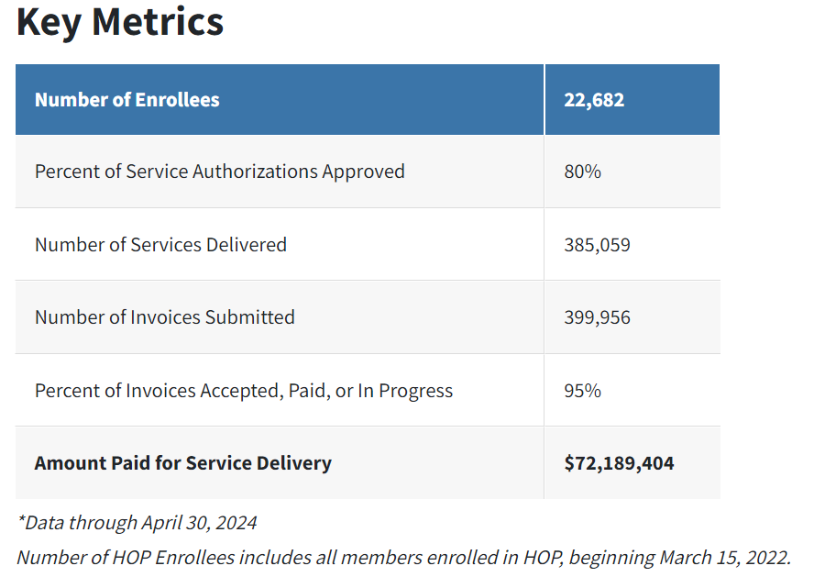

Slide 6
Challenges and Lessons Learned
Avoiding “overmedicalization”
1
Real-Time Monitoring and
Community Engagement
2
Importance of the Network
Lead Organization
3
Necessary Community Investment
4
Data Exchange Platforms
5
Integration into Existing Programs
6

Slide 7
Interim Evaluation Report (IER): Early Findings
The IER results, which examined several health, utilization, and cost indicators, show that the HOP concept—investing in housing, nutrition and other services to buy health—works. Receiving services provided through HOP has reduced social need, utilization and total cost of care for the studied population.
HOP participation results in:
Significantly lower health care expenditures with $85 less per beneficiary per month, after accounting for HOP service delivery spending¹
Decreased hospital utilization, including:
Decreased emergency department utilization relative to non-HOP beneficiaries.
Decreased inpatient hospitalization for non-pregnant adults relative to non-HOP beneficiaries.
Reduced risks of food, housing and transportation needs
HOP Engagement as of November 30, 2023:
50,585 beneficiaries (9.1% of total population) in Pilot Regions screened for qualifying needs
13,271 unique individuals enrolled
198,291 services delivered (15.6 average service deliveries per member served).*
89% of HOP Members with an unmet need received at least one HOP service
¹ This finding is based on interrupted time series and difference-in-difference analysis and highlights lower health care expenditures relative to what would have occurred in the absence of the Pilot.
*SOURCE: Unite Us Insights Dashboard, Payments Activity View, Payment Activity Overview Tab, Program filter. Data through October 31, 2023 as of November 14, 2023.

Slide 8
Questions & Discussion
Contact Information
Maria Ramirez Perez
Associate Director of Healthy Opportunities
NC Medicaid
Maria.perez@dhhs.nc.gov

